Slide 1
Customer Rating prediction
Aaron Dsouza

Slide 2
Agenda / Topics
Problem Definition
Data Analysis
EDA (Exploratory Data Analysis)
Pre-processing Pipeline
Building Machine Learning Models
Concluding Remarks
Aaron Dsouza

Slide 3
Problem Definition
The rise in E — commerce, has brought a significant rise in the importance of customer reviews.
There are hundreds of review sites online and massive amounts of reviews for every product.
Customers have changed their way of shopping and according to a recent survey, 70 percent of customers say that they use rating filters to filter out low rated items in their searches.
The ability to successfully decide whether a review will be helpful to other customers and thus give the product more exposure is vital to companies that support these reviews, companies like Google, Amazon and Yelp!.

Slide 4
Data Analysis
In the present era, most of the data on the internet is in the form of raw text. These gold mines of data are invaluable since it contains lots of underlying information which can be extracted using natural language processing or text analytics techniques.
To accomplish it, the prediction problem is transformed into a multi-class classification task to classify reviews to one of the five classes corresponding to its star rating.

Slide 5
Data Analysis
We have a client who has a website where people write different reviews for technical products.
Now they are adding a new feature to their website i.e. The reviewer will have to add stars(rating) as well with the review.
The rating is out 5 stars and it only has 5 options available 1 star, 2 stars, 3 stars, 4 stars, 5 stars. Now they want to predict ratings for the reviews which were written in the past and they don’t have a rating. So, we have to build an application which can predict the rating by seeing the review.
As an aspiring Data Scientist my task is to preprocess the text data and use the features derived from textual reviews to predict it’s corresponding star ratings.

Slide 6
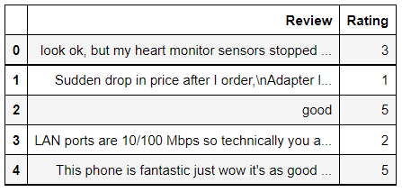
Data Analysis
Data frame Sample

Slide 7
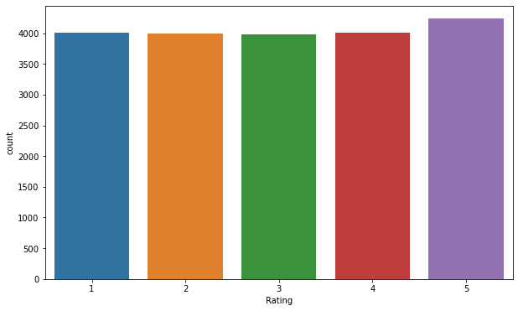
EDA (Exploratory Data Analysis)
Fig. 1 Rating count
From the figure we can conclude that the dependent variable rating is balanced.

Slide 8
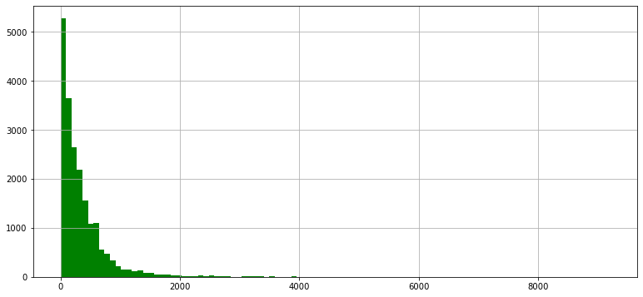
EDA (Exploratory Data Analysis)
Fig.2 Review length
Most of the reviews are very short but, there are also some very long reviews with word lengths up to 4000.

Slide 9
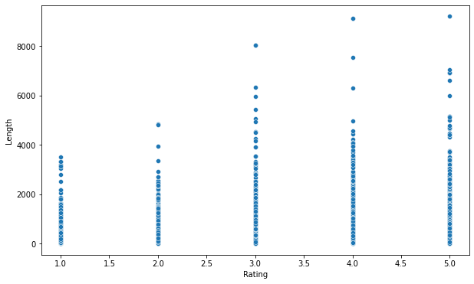
EDA (Exploratory Data Analysis)
Fig3. Rating vs Length
we can clearly observe that, High reviews are having longer message length.

Slide 10
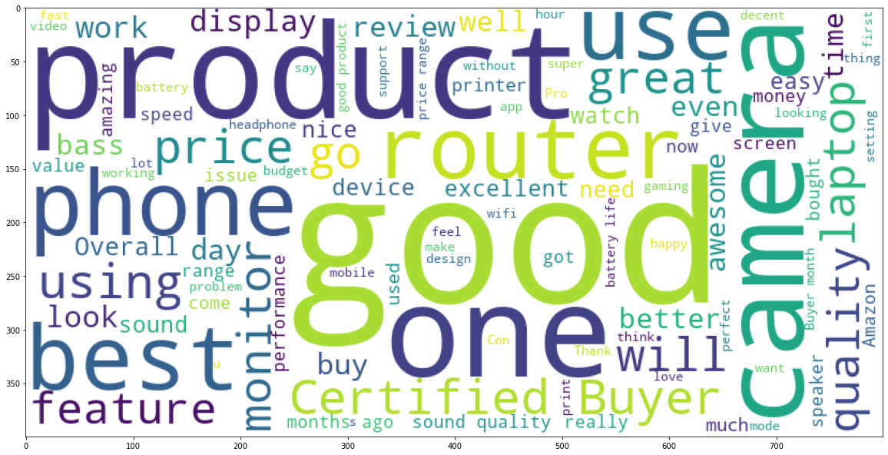
EDA (Exploratory Data Analysis)
Fig.4 Word cloud 5 star

Slide 11
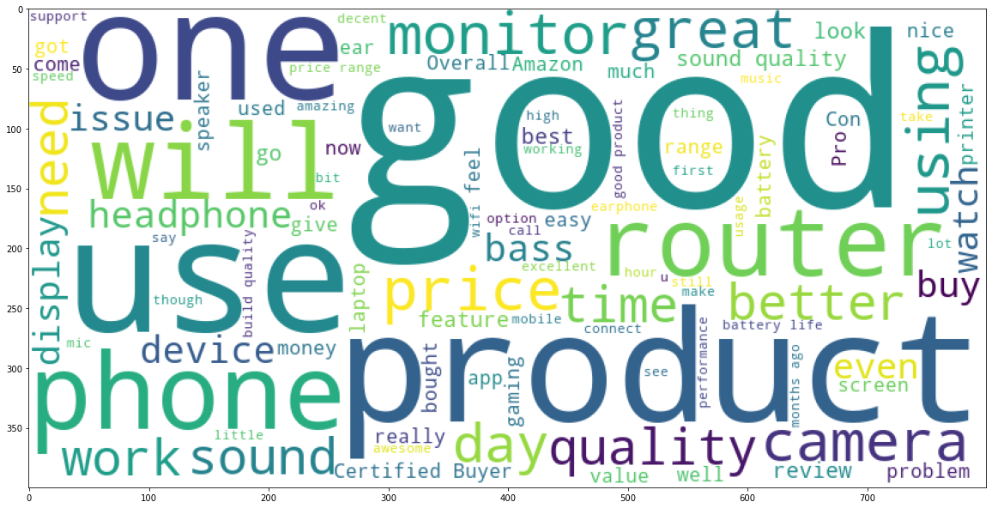
EDA (Exploratory Data Analysis)
Fig 5 Word cloud 4 star

Slide 12
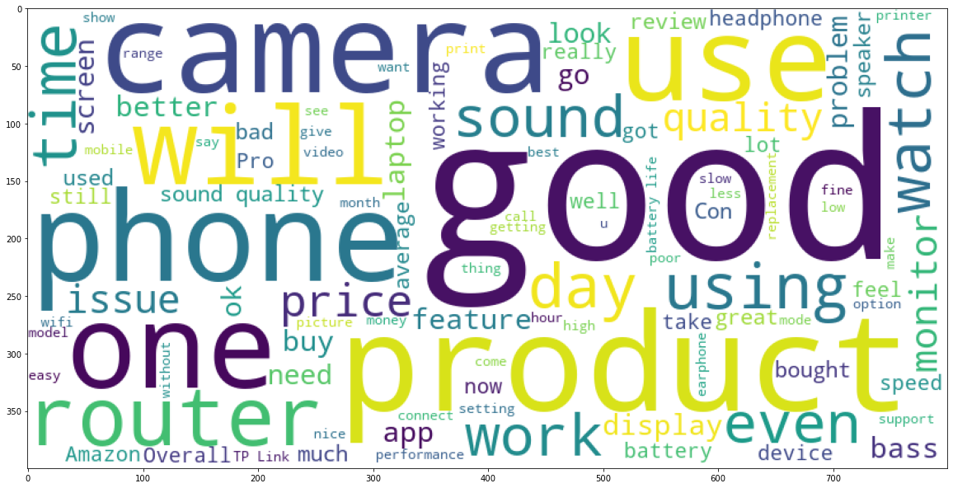
EDA (Exploratory Data Analysis)
Fig 6 Word cloud 3 star

Slide 13
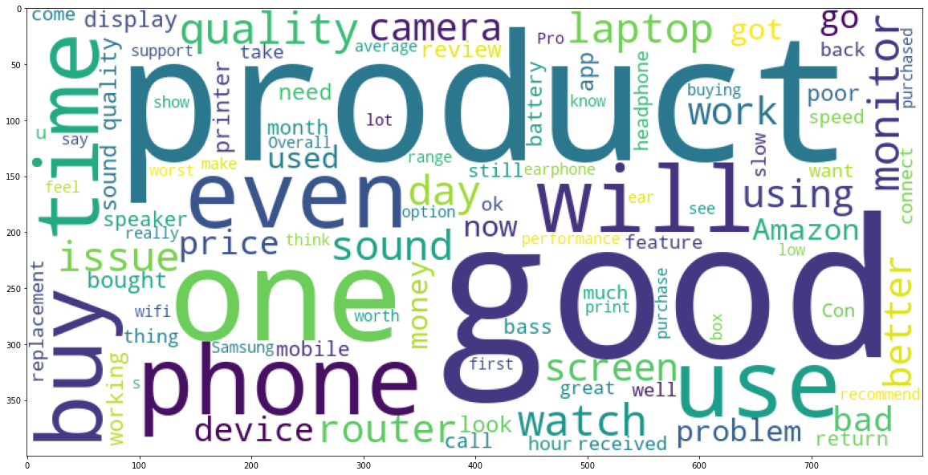
EDA (Exploratory Data Analysis)
Fig 7 Word cloud 2 star

Slide 14
EDA (Exploratory Data Analysis)
Fig 8 Word cloud 1 star

Slide 15
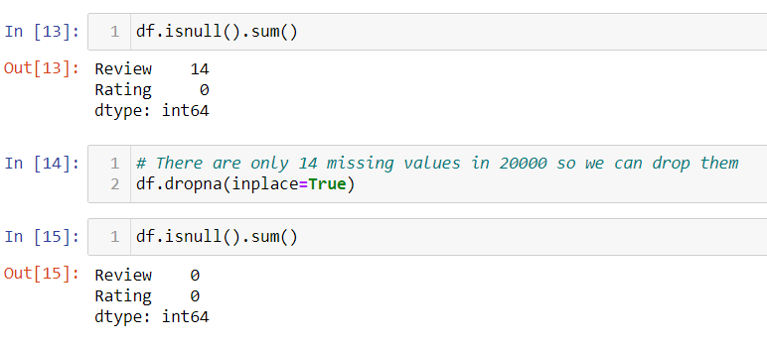
Pre-processing Pipeline
Dropping Null values

Slide 16
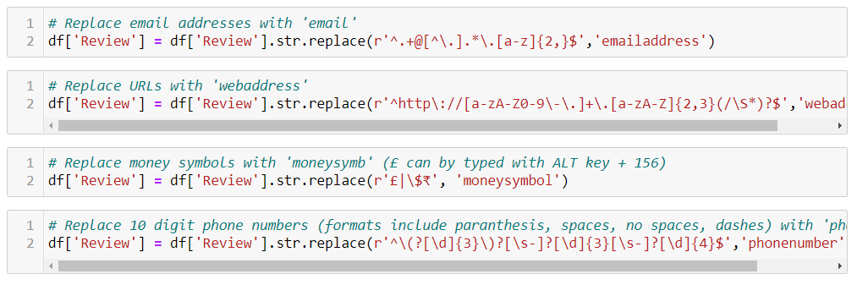
Pre-processing Pipeline
Replacing all the email addresses, web addresses money symbols and phone numbers

Slide 17
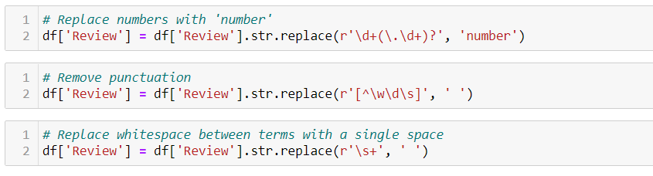
Pre-processing Pipeline
Replacing all the Numbers , punctuations and white spaces from text

Slide 18
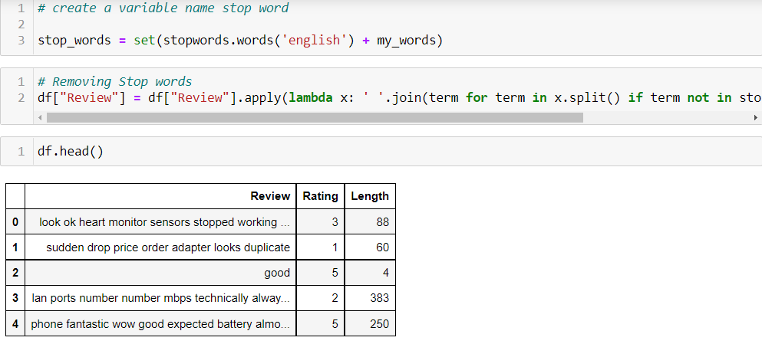
Pre-processing Pipeline
Removing all the stop words from the text

Slide 19
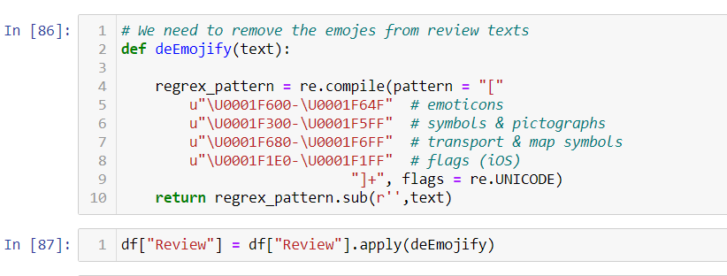
Pre-processing Pipeline
Removing all the emojis from the text

Slide 20
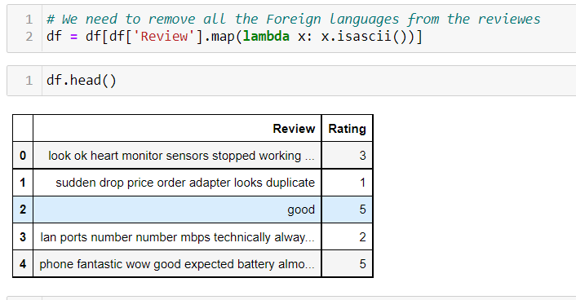
Pre-processing Pipeline
Removing all the foreign languages from the text

Slide 21
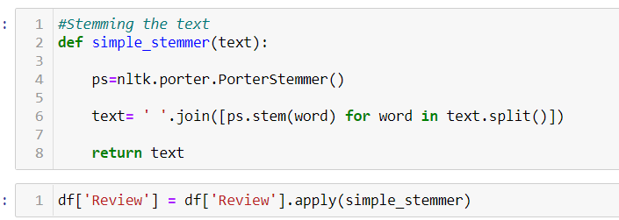
Pre-processing Pipeline
Using porter steamer on individual words

Slide 22
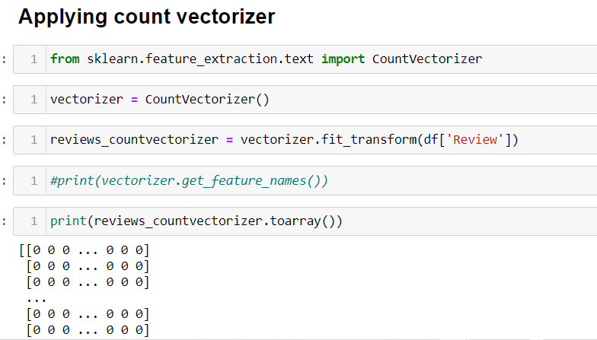
Building Machine Learning Models
Bags of words model

Slide 23
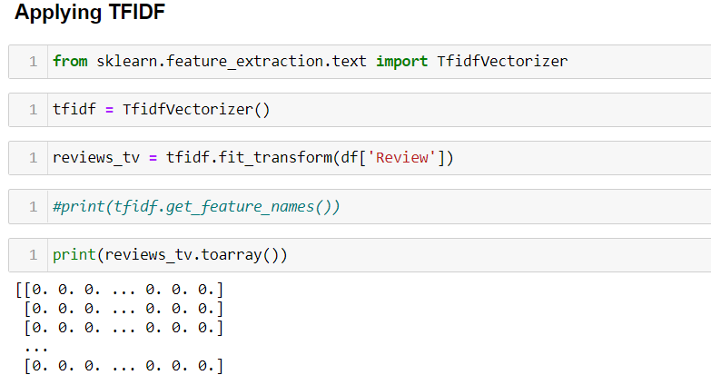
Building Machine Learning Models
Term Frequency-Inverse Document Frequency model (TF-IDF)

Slide 24
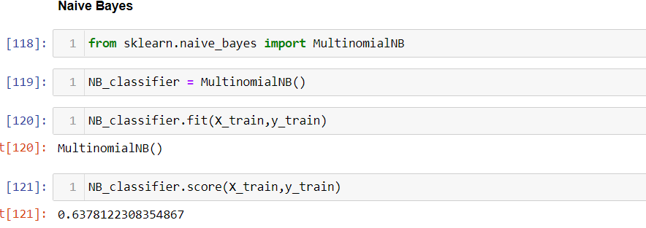
Building Machine Learning Models
Naive Bayes
Training accuracy: 63 %
Validation accuracy: 51 %

Slide 25
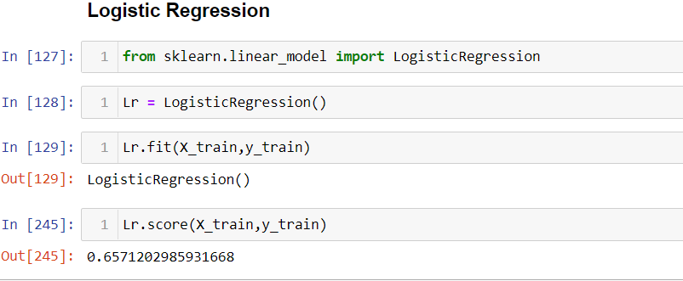
Building Machine Learning Models
Logistic Regression
Training accuracy: 66%
Validation accuracy: 57%

Slide 26
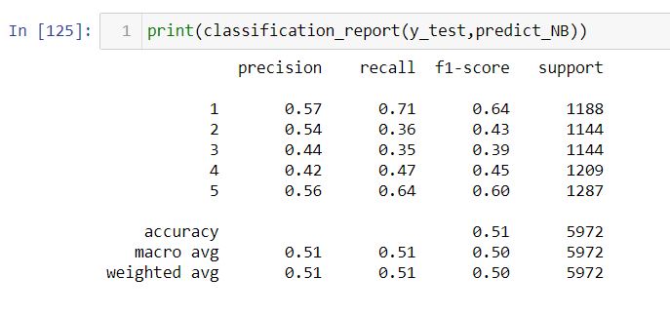
Building Machine Learning Models
Classification report for Multinomial Classifier

Slide 27
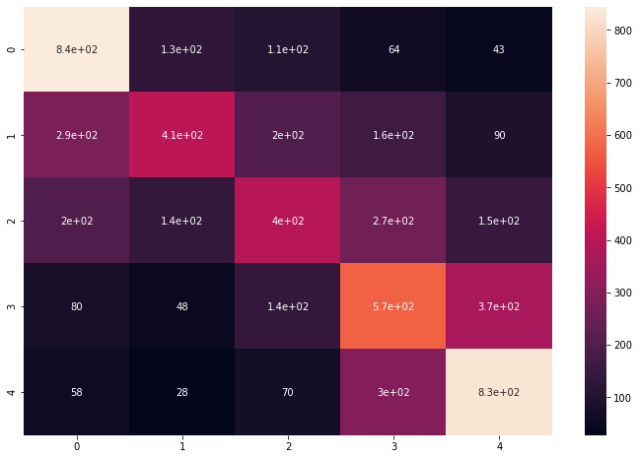
Building Machine Learning Models
Confusion Matrix for Multinomial Classifier

Slide 28
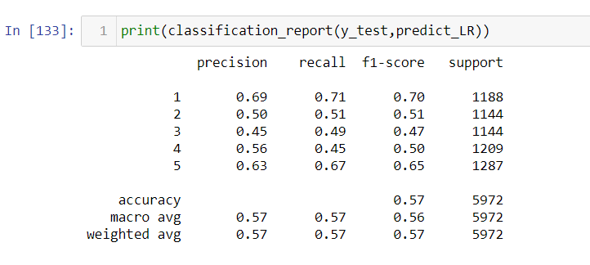
Building Machine Learning Models
Classification report for Logistic Regression

Slide 29
Building Machine Learning Models
Confusion Matrix for Logistic Regression

Slide 30
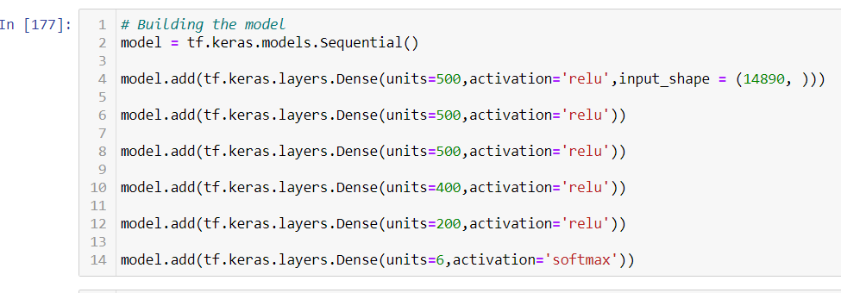
Building Machine Learning Models
Building an Artificial Neural network

Slide 31
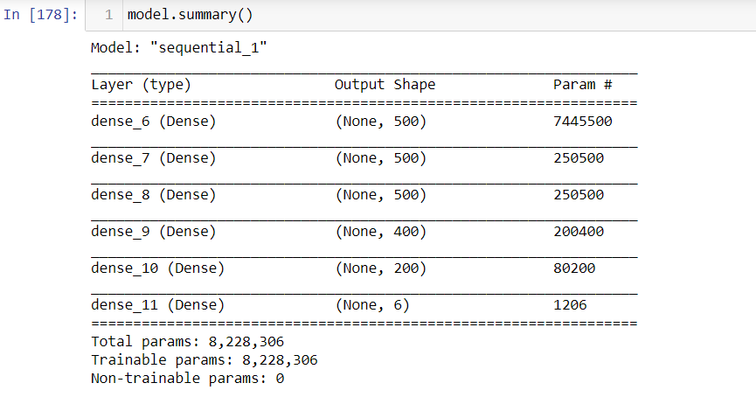
Building Machine Learning Models
Model Summary

Slide 32
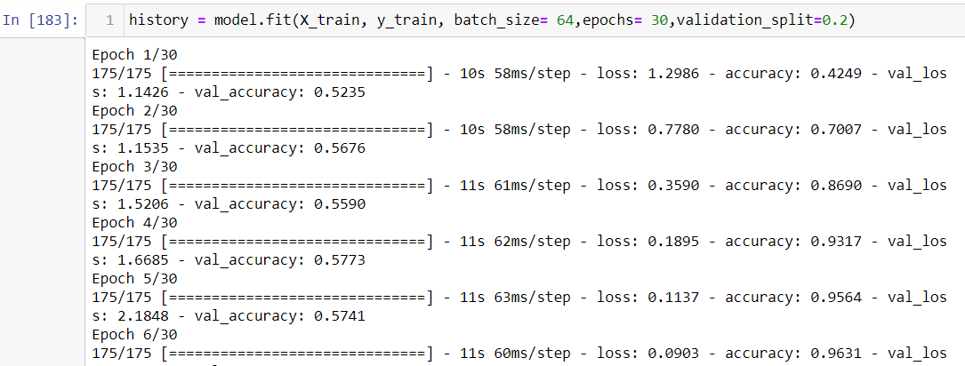
Building Machine Learning Models
Compiling the model

Slide 33
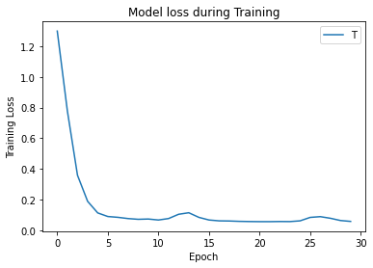
Building Machine Learning Models
Training loss vs Epoch

Slide 34
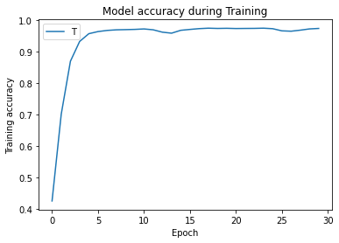
Building Machine Learning Models
Training accuracy vs Epoch

Slide 35
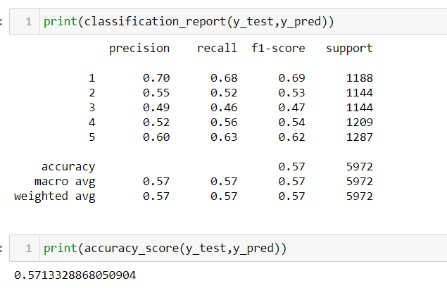
Building Machine Learning Models
ANN model accuracy: 57 %
ANN model Classification report

Slide 36
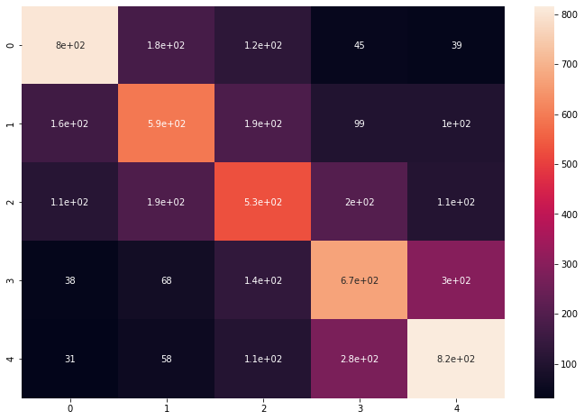
Building Machine Learning Models
ANN model Confusion matrix

Slide 37
Concluding Remarks
From the results obtained, we find that classifiers models are able to predict ratings of the reviews using various features derived from its textual content with a decent accuracy.
This suggests a strong correlation between the customer reviews (in-text property) and ratings (out-of text property) we considered for our analysis.
Hence, it answers the question: Sentiments of the text reviews do affect its corresponding ratings. It has been observed that among the features used for classification, polarity of the review and length of the review are more influential and highly correlated with its rating.

